Slide 1
Project Car Dataset Analysis
Presented by---
Vikas Budhani.
Meenakshi Ghansela

Slide 2
Object is to lunch new car Suzuki

Slide 3
SQL Queries
create table car_details(
ID int,
model_ID tinyint,
year smallint,
price int,
Milage int,
tax smallint,
mpg float(2),
engineSiz float (2),
transmission_id tinyint,
fuel_id tinyint);
Created the source Table names
as Car_Details in data base db_car.

Slide 4
Join the tables with each others.
INSERT INTO car_details
SELECT * FROM audi
UNION ALL
SELECT * FROM cclass
UNION ALL
SELECT * FROM bmw
UNION ALL
SELECT * FROM hyndai
UNION ALL
SELECT * FROM merc
order by ID ;

Slide 5
Add column in Car_Details
--ALTER INCOMESHARE
alter table car_details add Income_share varchar(50);
------Update the column in Income share of UK citizens base on price of cars
update car_details set Income_share = 'Top class' where price <= 54000;
update car_details set Income_share = 'Second Top class' where price <= 35700;
update car_details set Income_share = 'Middle Class' where price <= 26800;
update car_details set Income_share = 'Second lowest' where price <= 20500;
update car_details set Income_share ='First lowest' where price <13300;
--add column name Car_brand
alter table car_details add car_Brand varchar(50);

Slide 6
Updating car brands
--update car_brands
update car_details
set car_Brand = 'Audi'
where ID>0 and ID< = 10668;
Update car_details
set car_Brand = 'Merc' where id>=14568 and id<=27686 ;
Update car_details
set car_Brand = 'BMW' where ID >=27687 and ID<=38467;
Update car_details
set car_Brand = 'Hyndai' where ID>=38468 and Id<=43327;
update car_details
set car_brand = ‘Cclass' where ID> =10669 and ID<=14567;
--- add Coumn in cclass
Alter table cclass add tax smallint;
alter table cclass add mpg real;

Slide 7
Joining the car_details with Fueltype , Model Name , Transmission
select car_details.*, fueltype.*, models.*, transmission.* from (select *,
case when Price >= 140000 then 'Catg A'
when price > =100000 then 'Catg B'
when price >=80000 then 'catg C'
when price >= 50000 then 'Catg D'
when price >= 20000 then 'catg E'
else 'Catg F'
end as Category_by_price
from car_details)car_details
inner join fueltype on car_details.fuel_id = fueltype.fuel_ID
inner join models on car_details.model_ID = models.model_ID
inner join transmission on car_details.transmission_id = transmission.ID order by car_details.ID;

Slide 8
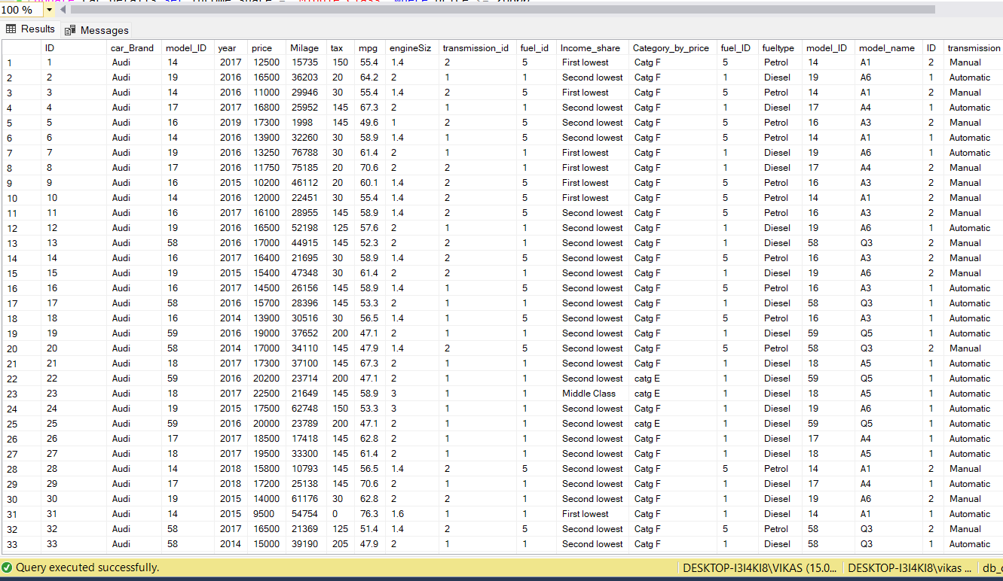

Slide 9
Few Insights
1 –
Income class of UK citizens based on price of Cars
The Annual Income of the UK Citizens are –
Top class – 54000
Second Top class –35700
Second lowest –26800
Middle class – 20500
First Lowest - 13300

Slide 10
We have jump sale between 2018 to 2019 .in category F
Prices jump between 2018 to 2019 category E
Highest selling Engine size are 2 , 2.1 , 3.
Top selling car is merc – 13119 unit
Most of the customer Buy Diesel fuel type car
Most of the customer buy Semi-Auto car.

Slide 11
Conclusion
We can Launch car according to the analysis -
Cost of the car between 50,000 to 20,000.
Engine size – 2, 2.1 , 3 .
Fuel type must be Diesel.
Car should be Semi Auto.

Slide 12
THANK YOU

